Slide 1
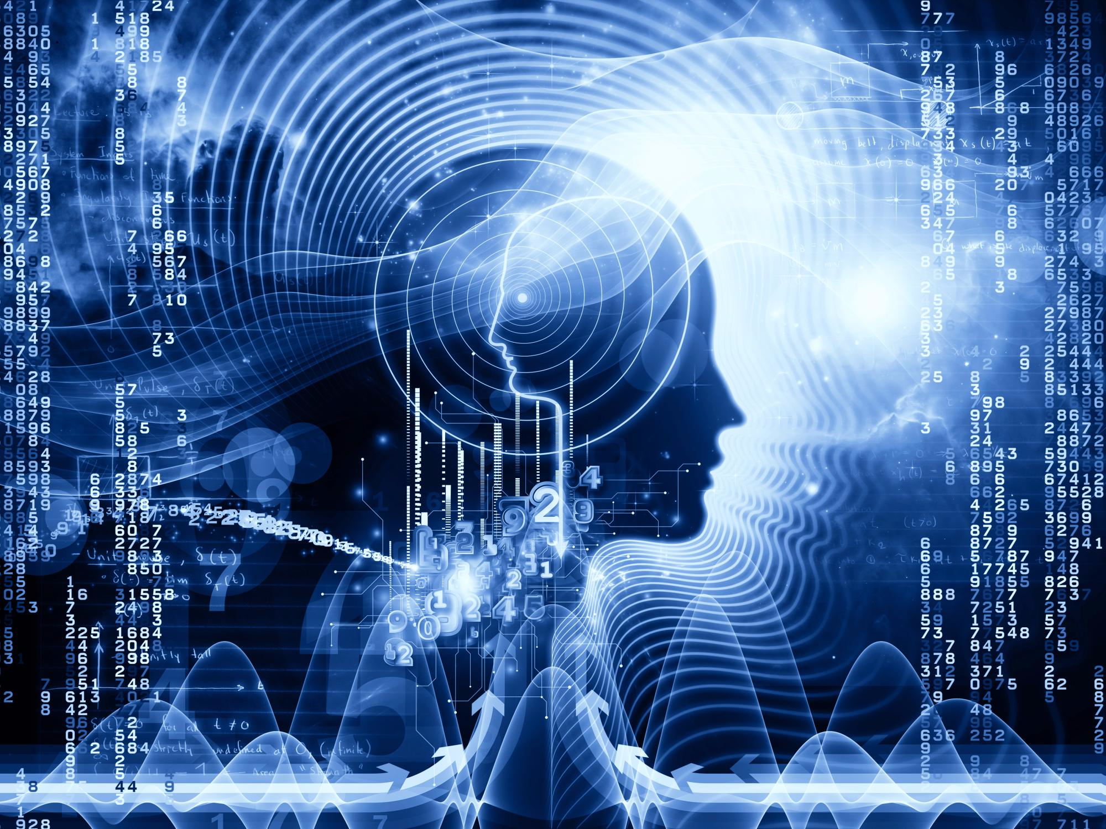

Data Science for Document Analysis and Understanding
Team Member: GE Chongjian
XIAO Rudan
LIANG Mingzhu
2019-7-25

Slide 2

Presentation Contents
01
02
Background
Methods & Result
NLP-related tasks
Vector space model
LSTM
XML annotation
Word frequency analysis
Emotion analysis
https://github.com/RhettGee/AMMI_Emotional_scoring_NLP

Slide 3
Background — NLP related task
01
Text
Sequence labeling problem
01
01
Named entity
Brand word recognition
Part of speech tagging
Syntax analysis
New word discovery
04
Automatic writing
Automatically write poetry
Text summary
Chat robot
Automatic question and answer
Voice synthesis
NLP
(Natural Language Processing)
Text
Text
generate problem
04
Classification problem
02
02
Emotion analysis
Category
Intention recognition
Rewrite problem
03
03
Query extension
Rewrite
Error correction
Translation

Slide 4
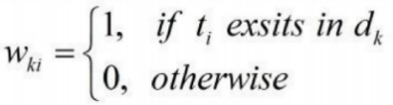
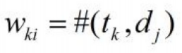
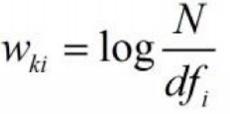
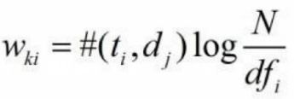
Background — Vector Space Model
Vector space model: An algebraic model for representing text documents (and any objects, in general) as vectors of identifiers, such as, for example, index terms. It is used in information filtering, information retrieval, indexing and relevancy rankings.
Term-document matrix: A mathematical matrix that describes the frequency of terms that occur in a collection of documents.
Bool
(presence)
Term Frequency
(TF)
term weight of feature words
Inverse Document Frequency
(IDF)
TF-IDF
TF-IDF combines the properties of both TF and IDF features

Slide 5
Background — LSTM
Output gate
Improved:
1.Forget gate
2. Activation function : logistic sigmoid or tanh.
3. Replace CEC weight 1.0 by
the multiplicative forget gate
activation .
h
Cell
Forget gate
Input gate
g

Slide 6
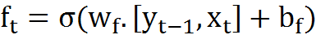
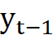
Background — LSTM
Output gate
h
Cell
Forget gate
Input gate
g

Slide 7
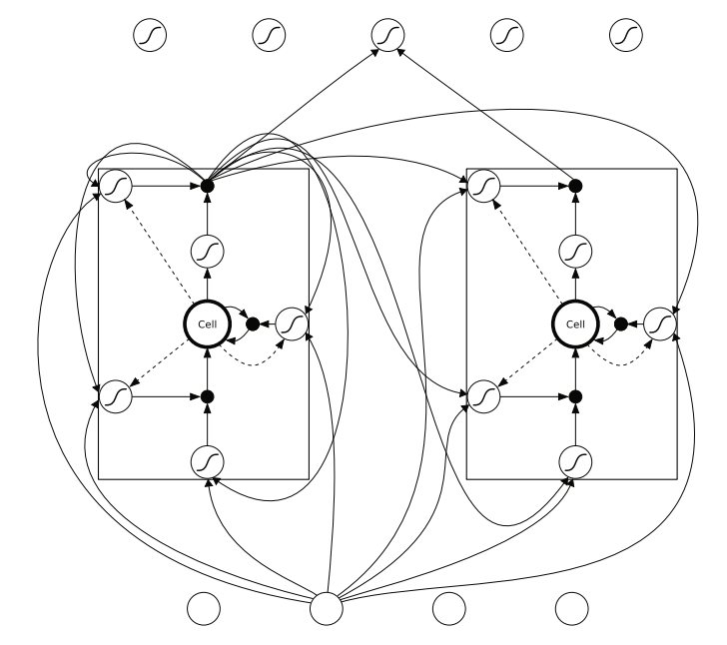
Background — LSTM
Example: An LSTM Network

Slide 8
Background — LSTM
Preservation of gradient information by LSTM
Outputs
_
_
_
_
_
_
o
o
o
|
o
|
o
|
o
|
o
|
Hidden
Layer
o
o
_
_
_
_
_
Input
Time
1
2
3
4
5
6

Slide 9
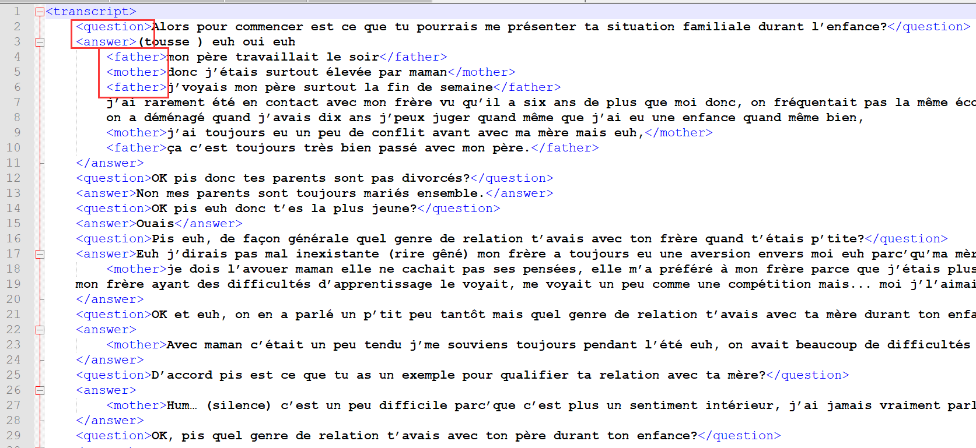
Methods & Result — XML annotation
Software: Notepad++
Structure
Root
Question
Answer
Father
Mother
Partner

Slide 10
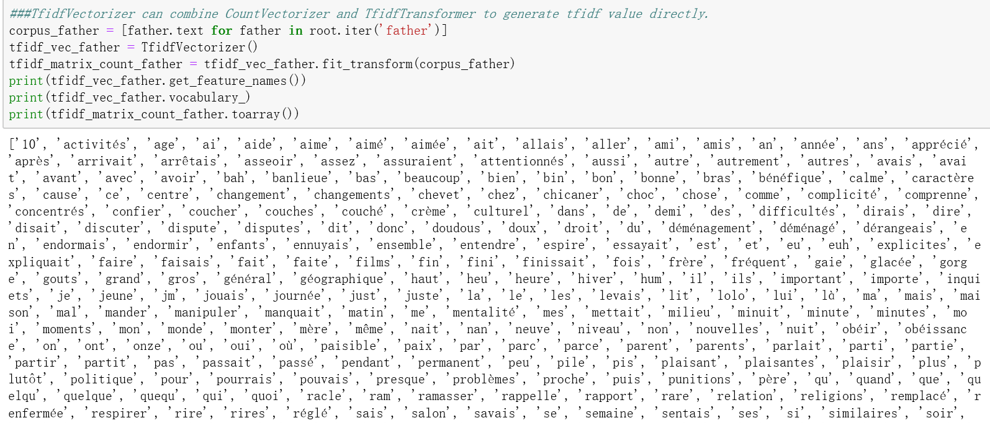
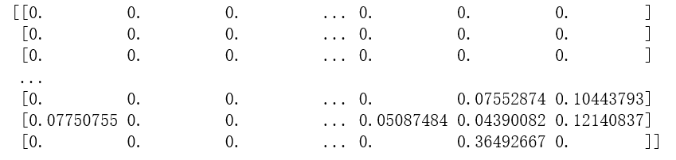
Methods & Result — Word frequency analysis
Method: TF-IDF (term frequency times inverse document frequency)
The term weight of each word represents the importance of the word for the article

Slide 11
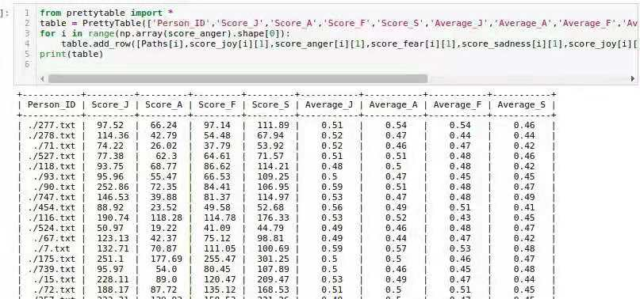
Methods & Result — Emotion analysis
Method: Emotional matching analysis

Slide 12
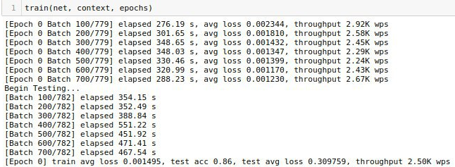
Methods & Result — LSTM

Slide 13
Thanks

